Slide 1

Machine Learning
By 1stmentor.com

Slide 2
What all will you learn in this course?
Introduction to Machine Learning
Basics of Python
Applied Statistics
EDA
Machine Learning and its Types
Ensemble Learning
Final Project
Notes:
EDA : Exploratory Data Analysis, here we try and understand all that we can about the data before putting it into a machine learning model.

Slide 3
Introduction to Machine Learning
By 1stmentor.com

Slide 4
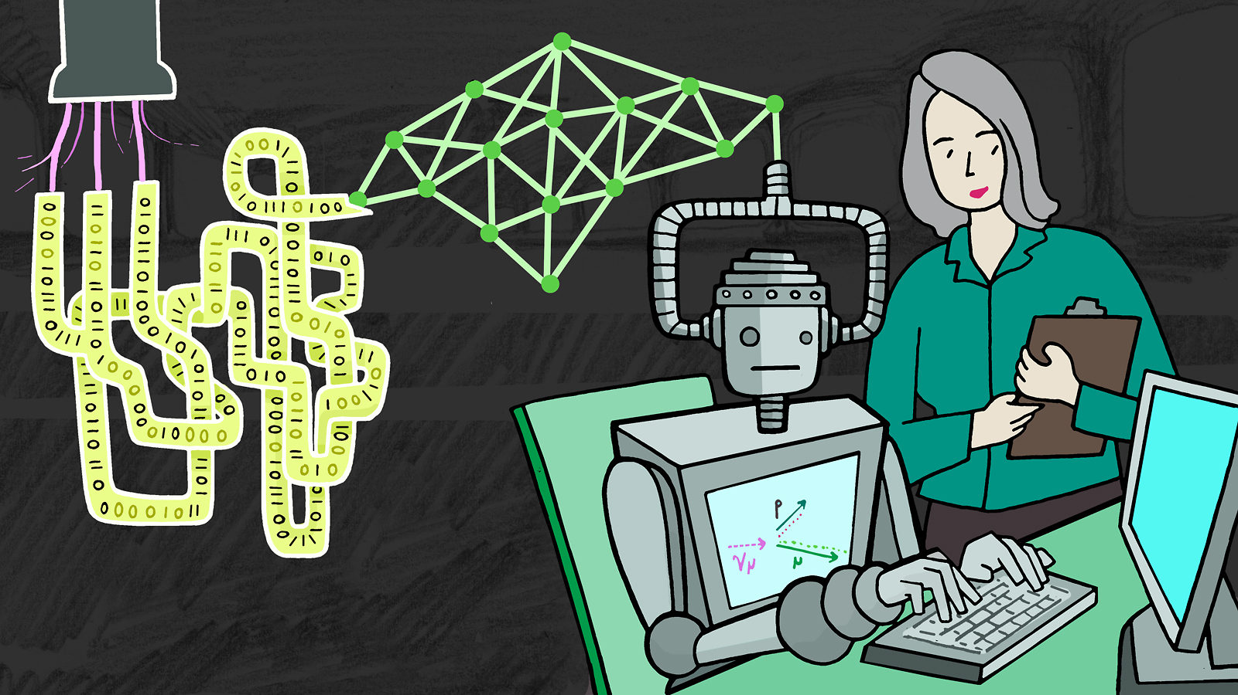
What is Machine Learning ?
Bookish Definition:
Machine learning is a branch of artificial intelligence (AI) and computer science which focuses on the use of data and algorithms to imitate the way that humans learn, gradually improving its accuracy.
Layman Definition:
It is the use of data to help the computer understand various patterns which helps it make better predictions (better accuracy).

Slide 5
Why do we use Machine learning ?
Machine Learning helps us make better predictions. It is like knowing approximately what’s going to happen in the future. Almost every field now used machine learning. Let’s Discuss a few.
Stock Market Price Predictions (Finance)
Recommendation System (Entertainment / Sales)
Customer Segmentation (All Fields)
Fraud Detection (Insurance)

Slide 6

Stock Market Price Predictions (Finance)
Stock Market has huge variations in the prices every second and tons is generated on a daily basis, understanding the data, deriving useful information and patterns and then making predictions is one of the use cases of Machine Learning.
Notes:
Image : https://www.freepik.com/vectors/business

Slide 7

Recommendation System (Entertainment / Sales)
A system that looks into the various factors it is provided with and then makes similar suggestions based on that.
The recommendations made by the program, can be judged on the basis of how appealing are they to the customers.
If it works perfectly, then the GIF on the right comes true.
Notes:
Factors are nothing but attributes of any object. Example: A human has 2 hands and 2 legs and no tail or long ears and has an average height of 5-6 ft. Where as an Elephant has 4 legs 0 hands, has a small tail, has long ears and has an average height of 10-12 ft. As the characters / attributes are very different we can easily differentiate them.

Slide 8
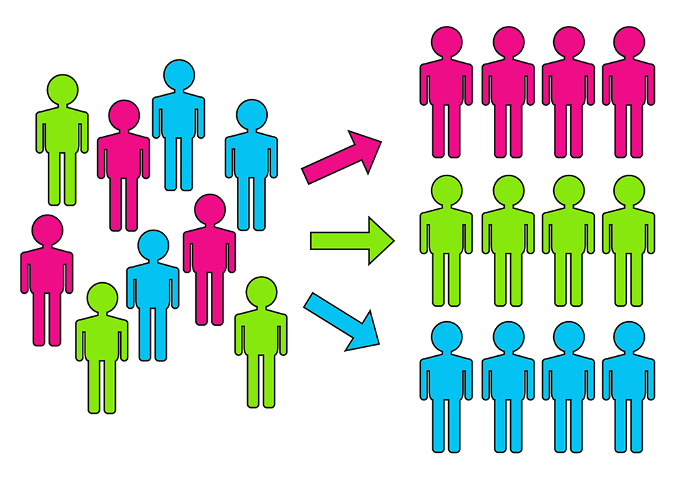
Customer Segmentation (All Fields)
This system helps us segregate the customers on the basis of various factors and then cater to them separately so that we can get the best results.
We again use various factors to identify and determine which customer falls into which group.

Slide 9

Fraud Detection (Insurance)
The system predicts if a particular transactions seems to be a fraud or not. This is one of the famous use cases for ML.
With the advancement in technology, this topic has gain a lot of attention. It is becoming normal transactions are difficult to differentiate from the fraudulent ones as the days pass by.

Slide 10

How do I start ?
There are some basic requirements that is necessary before you dive into the Machine Learning aspect of this course.
You must know how to code. (in any language)
Basic understanding of statistics (applied statistics)
Basic understanding of mathematics (applied math)
If you do not fulfill these requirement at the moment, no need to worry, cause we cover all of these aspects in the course. You will also apply this knowledge in your programs, making your concepts even more clear.

Slide 11

What language is the best to code in?
For beginners Python has proven to be the most appealing to many. The english like syntax, huge number of libraries to choose from and it being an open source project makes it the ideal choice for beginners.
Other programming languages can also be used for developing Machine learning applications but for this course we will stick to Python. But I really do appreciate all the people willing to try this out it other programming languages.

